Slide 1
Data Structures
Muhammad Usman Joyia

Slide 2
Course Objective
Introduce the basic concepts of data structures /ADTs, and use them efficiently in algorithms for solving various problems using C/C++
What should you expect in this course?
  Extensive programming
  A lot of thinking
What should you learn by the end of this course
  Ability to understand common programming problems and design and implement efficient data structures to solve them
DEPARTMENT OF COMPUTER SCIENCE, FAST-NU

Slide 3
Why should we study this course?
Well, because it is the core computer sciences course
Any other reason to study this course?
We want to make a successful career after graduation
The most common programming interviews questions
    Linked lists
    Strings
    Binary Trees
    Arrays
    Queues
Source: http://maxnoy.com/interviews.html
DEPARTMENT OF COMPUTER SCIENCE, FAST-NU

Slide 4
Introduction
Fundamentals of data structures
An overview of computer programming
Data types
Abstract data types
C/C++ Background
Review of pointers
  Defining pointer variables
Supplying values to pointer variables
DEPARTMENT OF COMPUTER SCIENCE, FAST-NU

Slide 5
Fundamentals of Data Structures

Slide 6
What is a data structure?
Data structures are used in almost every program or software system
In computer sciences, a data structure is a particular way of storing and organizing data in a computer so that it can be used efficiently
  Efficient data structures → Efficient algorithms
Focus: Efficiency and performance
  Time and space analysis of algorithms
Performance is the measure of quality of the work done by any machine.
efficiency is the ratio of desired output to the required input for any machine.
Source: http://en.wikipedia.org/wiki/Data_structure
DEPARTMENT OF COMPUTER SCIENCE, FAST-NU

Slide 7
Performance vs efficiency
Performance is the measure of quality of the work done by any machine.
Efficiency is the ratio of desired output to the required input for any machine.
DEPARTMENT OF COMPUTER SCIENCE, FAST-NU

Slide 8
Important characteristics of a good software
A good design
Easy to implement
Easy to use
Easy to maintain
Reliable solution of the given problem
→ So, the data structure to solve a particular problem should be selected with the above objectives in mind
Source: http://en.wikipedia.org/wiki/Data_structure
DEPARTMENT OF COMPUTER SCIENCE, FAST-NU

Slide 9
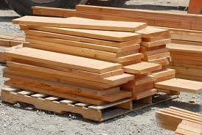
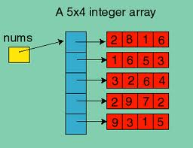
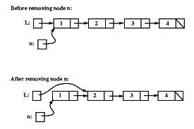
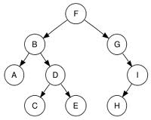
Some example data structures…
Arrays
Stack
Tree
Linked List
Data structure = representation and operations associated with a data type
DEPARTMENT OF COMPUTER SCIENCE, FAST-NU

Slide 10
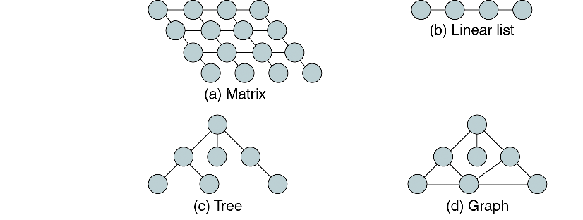
Example of data structure
DEPARTMENT OF COMPUTER SCIENCE, FAST-NU

Slide 11
Data structure applications
Arrays
  Consecutive memory locations
  lists (one dimensional arrays)
  matrices (two dimensional arrays)
  database applications
  to implement other data structures, such as heaps, hash tables, queues, stacks, strings
Stacks
  expression evaluation and syntax parsing
Queues
  scheduling
  transportation
  operations management
DEPARTMENT OF COMPUTER SCIENCE, FAST-NU

Slide 12
Data structure applications
Trees
  Efficient searching of data (binary search tree)
  Manipulate hierarchical data
  Manipulate sorted data
Linked lists
  Can be used to implement several other common abstract data structures, such as
    Stacks
    Queues
    Symbolic expressions, etc.
DEPARTMENT OF COMPUTER SCIENCE, FAST-NU

Slide 13
What is an algorithm?
In mathematics and computer science, an algorithm is a step-by-step procedure for solving a problem
  expressed as a finite list of well-defined instructions
  with a finite amount of data
  in a finite amount of time
Algorithms are used for
  calculations
  data processing, and
  solving complex problems?
In simple words:
  an algorithm is a step-by-step procedure for computations
DEPARTMENT OF COMPUTER SCIENCE, FAST-NU

Slide 14
Sample problem
What are the sequence of steps to be followed to start a car
DEPARTMENT OF COMPUTER SCIENCE, FAST-NU

Slide 15
The algorithm to start the car
  Insert the key
  Make sure car is in neutral gear
  Press the gas pedal/ (Accelerator)
  Turn the key to the start position
  If the engine starts in 6 seconds ➔
    Release the key to the ignition position
  Else if the engine does not start in 6 seconds ➔
    Release the key and gas pedal
    Wait for 10 seconds , and repeat the steps 3 – 6, but no more than 5 times
  If the car does not start
    Call the workshop
DEPARTMENT OF COMPUTER SCIENCE, FAST-NU

Slide 16
Data types
primitive data types in c/c++

Slide 17
Some primitive data types…
Name | Description | Size | Range
char | Character or small integer | 1 byte | signed: -128 to 127 unsigned: 0 to 255
Int | Integer | 4 bytes | signed: -2147483648 to 2147483647 unsigned: 0 to 4294967295
iong int (long) | Long integer | 4 bytes | signed: -2147483648 to 2147483647 unsigned: 0 to 4294967295
bool | Boolean value. It can take one of two values: true or false | 1 byte | true or false
float | Floating point number | 4 bytes | +/- 3.4e +/- 38 (~7 digits)
double | Double precision floating point number | 8 bytes | +/- 1.7e +/- 308 (~15 digits)
long double | Long double precision floating point number | 8 bytes | +/- 1.7e +/- 308 (~15 digits)
DEPARTMENT OF COMPUTER SCIENCE, FAST-NU

Slide 18
Arrays
Used to store a collection of elements (variables)
type array-name[size];
Meaning:
This declares a variable called <array-name> which contains <size> elements of type <type>
The elements of an array can be accessed as: array-name[0],…array-name[size-1]
Example:
int a[100]; //a is a list of 100 integers, a[0], a[1], …a[99]
double b[50];
char c[10];
DEPARTMENT OF COMPUTER SCIENCE, FAST-NU

Slide 19
Abstract data types
Abstraction – Omitting or hiding low-level details with a simpler, higher-level idea. For example, the user only has to understand the preconditions and postconditions of the program, not the full internal behavior of the it.
Abstract data types is a powerful idea that enables to separate how we use a data structure in a program from the particular form of the data structure itself.
Reading: https://web.mit.edu/6.031/www/sp17/classes/12-abstract-data-types/
DEPARTMENT OF COMPUTER SCIENCE, FAST-NU

Slide 20
Abstract data type
In computer science, an abstract data type (ADT) is a mathematical model for data types, where a data type is defined by its behavior (semantics) from the point of view of a user of the data, specifically in terms of possible values, possible operations on data of this type, and the behavior of these operations
ADT users are NOT concerned with how the task is done but rather what it can do.
An abstract data type is a data declaration packaged together with the operations that are meaningful for the data type.
DEPARTMENT OF COMPUTER SCIENCE, FAST-NU
Notes:
The key idea of data abstraction is that a type is characterized by the operations you can perform on it.
A number is something you can add and multiply; a string is something you can concatenate and take substrings of; a boolean is something you can negate, and so on. All that matters is the operations!
In the same sense you can create a Date ADT having integer fields for day, month and year. Same goes for Address ADT with string fields for landmark, city and country.
User of the ADTs would not need to worry about how its values were stored, in the same way that a programmer can ignore how the compiler stores integers.

Slide 21
Abstract data types: Example
Example: abstract stack (functional)
A complete functional-style definition of a stack ADT could use the three operations:
  push: takes current stack state and an arbitrary value, insert it into the stack and returns updated state;
  top: takes a current state, returns a value;
  pop: takes current state, delete a value from top, returns updated state;
DEPARTMENT OF COMPUTER SCIENCE, FAST-NU

Slide 22
Abstract data types: Excercise
Consider an abstract data type Bool. The type has the following operations:
true : Bool
false : Bool
and(Bool, Bool) : Bool
Or(Bool × Bool) : Bool
Not(Bool) : Bool
… where the first two operations construct the two values of the type, and the last three operations have the usual meanings of logical and, logical or, and logical not on those values.
DEPARTMENT OF COMPUTER SCIENCE, FAST-NU

Slide 23
Answer the following…
Which of the following are possible ways that Bool might be implemented, and still be able to satisfy the specs of the operations? Choose all that apply.
  As a single bit, where 1 means true and 0 means false.
  As an int value where 5 means true and 8 means false.
  As a reference to a String object where "false" means true and "true" means false.
  As a long value where all possible values mean true.
  As an int value > 1 where prime numbers mean true and composite numbers mean false.
DEPARTMENT OF COMPUTER SCIENCE, FAST-NU

Slide 24
Explanation
All are correct.
Bool can be implemented by any kind of data structure, as long as it distinguishes the two values true and false along with the operations specified on the values.
That’s the essence of what makes an abstract data type. The operations themselves (and their specs) completely define the data type, abstracting away from the details of data structure, memory storage, or implementation. It’s a Bool data type because it provides these operations, not because of how it’s actually stored inside the machine
DEPARTMENT OF COMPUTER SCIENCE, FAST-NU

